Slide 1

BRITANNIA

Slide 2
Comprehensive Digital Marketing Project Work On Britannia
Team Details
Team Leader : Chintu Niranjani
Team member: Chamarati Lakshmi
Team member : Gorle Lavanya
Team member : Kota Sirisha
Team member : Lingudi Madhavi

Slide 3
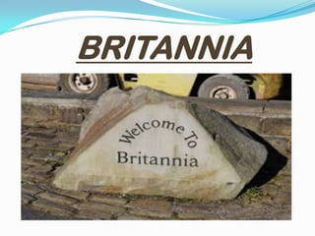
HISTORY
It is one of the premier food product company in India started its business in
Calcutta (now Kolkata) with an initial investment of Rs. 295 is a small biscuit company
and has grown to a household name.
Britannia was founded in 1892 by a group of British businessmen in Kolkata, India. At the time, it was known as Britannia Company Limited. The company's primary business was the manufacture and sale of biscuits.
GOAL: To provide consumers the highest standards of food safety and ensure hygiene in the new diversified food category

Slide 4
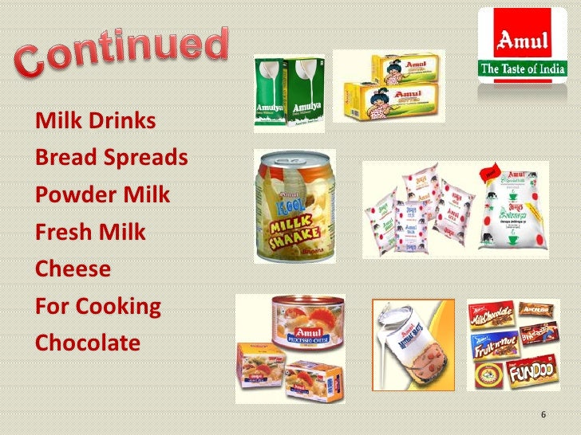
SEGMENTATION
The biscuit market in India can be segmented as follows:
Glucose
Marie
Digestive
Cream
Premium
Crackers

Slide 5

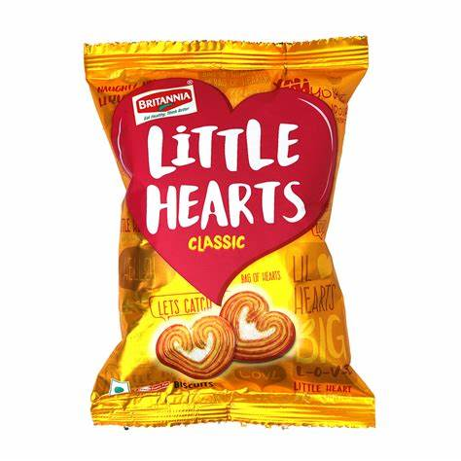
PRODUCTS
TIGER
Butterscotch, elaichi, strawberry, banana, orange, etc.
Key competitors like ITC(sun feast), surya foods(Priya gold), and parle agro do not provide such a wide range of flavoured glucose biscuits.
LITTLE HEARTS:
It is the only type of snack biscuit in the market.a wafer biscuit with sugar coating.
GOOD DAY
Britannia good day started premium biscuits enriched cashew,badam pista, etc(1986)

Slide 6
BRITANNIA IN OVERSEAS
Middle East:
In March 2007, Britannia Industries Limited formed a joint venture with Khimji Ramdas group
one of the largest and most respected business conglomerates in the Middle East.
It offers a wide spectrum of products under the brand @nutro,which is leading biscuit brand in the middle east
Sri Lanka
29th August 2008 goes down in the history of our company the day, when Britannia started manufacturing and marketing its product in srilanka

Slide 7
Content idea generation strategies
Product-Centric Content:
New Product Launches: Create content to announce and highlight new products and variants.
Recipe and Cooking Ideas:
Share recipes that incorporate Britannia products as ingredients.
Health and Wellness:
Nutritional Information: Share content about the nutritional benefits of Britannia products.
Brand Stories and History:
Share the history and journey of Britannia, emphasizing its legacy and contributions to the food industry.
Consumer Engagement:
User-Generated Content: Encourage customers to share their experiences and recipes using Britannia products on social media
Customer Testimonials:
Share stories and testimonials from satisfied customers and their experiences with Britannia products.
Global Market Insights:
Content that highlights Britannia's presence and performance in international market

Slide 8
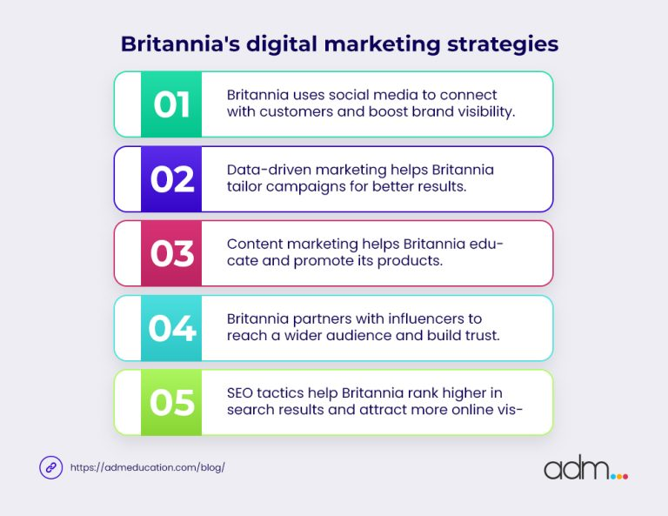

Slide 9
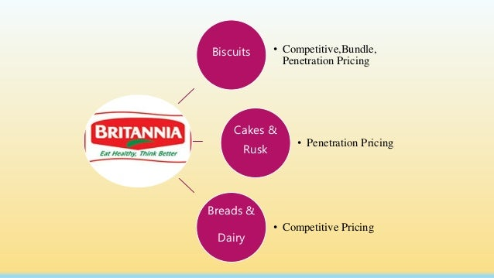
MARKET SEGMENTATION
Age group: different products for different age groups. E.g.. Tiger and Treat for kids, Little Hearts for youth, and Good Day for older ones.
Niche snacking segment: For Those individuals who are on the go, the company introduced
small packets.
Occasions: Britannians subh kaamnayein is for special occasions like festivals.

Slide 10
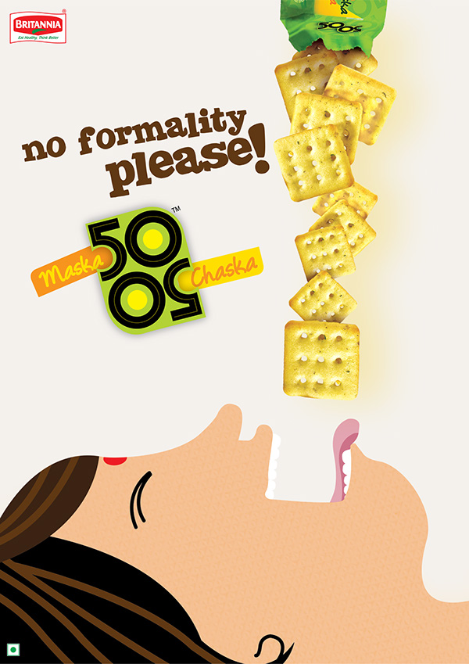
PRICE
All the biscuits under Britannia have kept appropriate pricing.
Every biscuit has economy packs to family packs.
This style covers every economic segment in the market.
PUBLIC RELATION+DIRECT MARKETING
Buying biscuits means buying health nutrition and food, Britannia conducted by qualitative and quantitative research, surveying over 5000 consumers, how they perceived the brand
ADVERTISING CHANNELS
Press Advertisement
Television advertisement
Radio Advertising

Slide 11
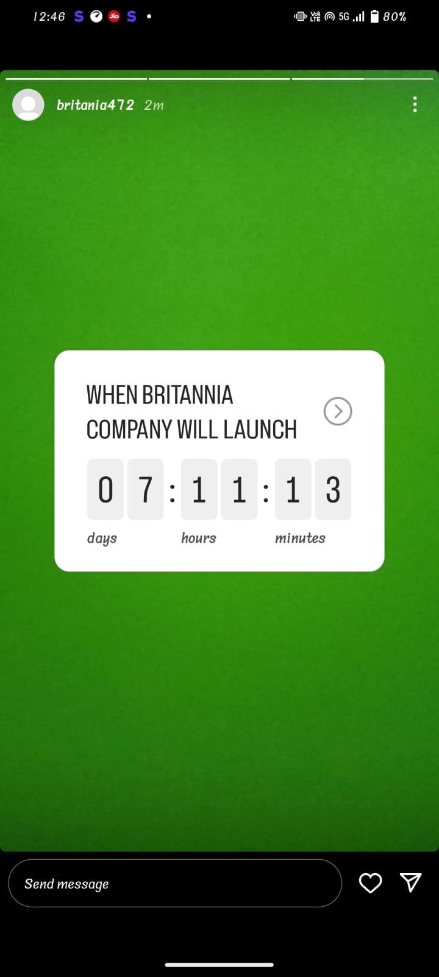
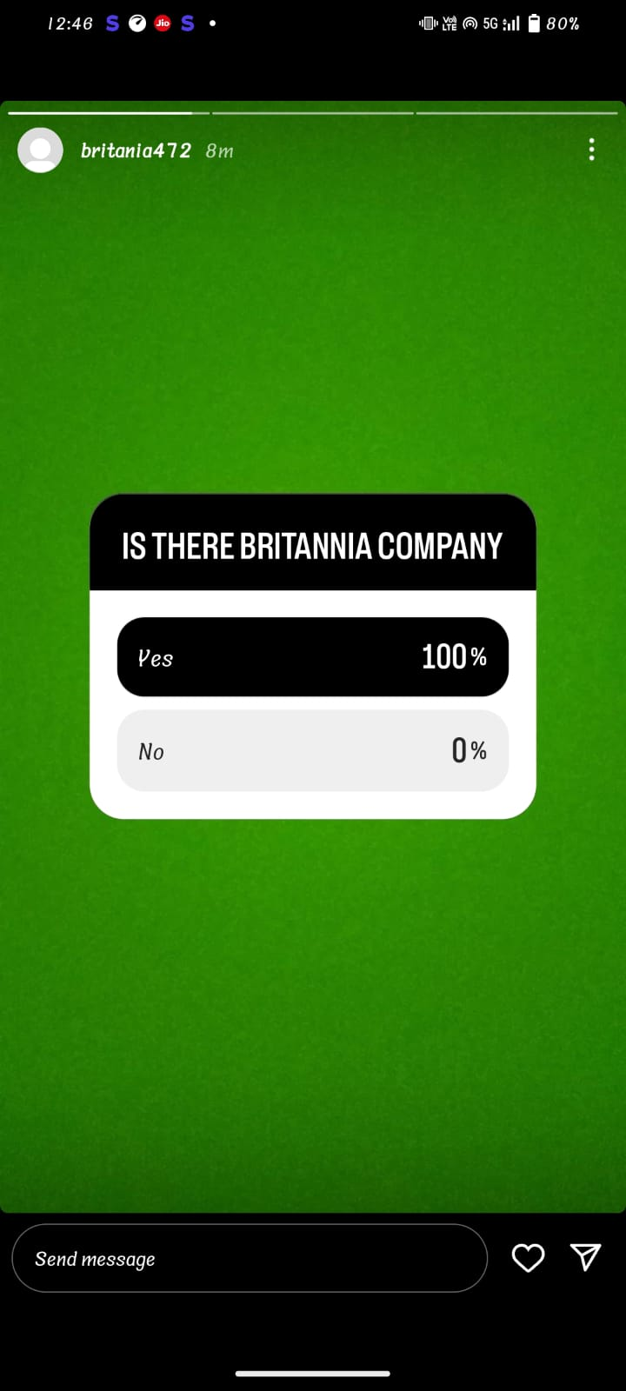
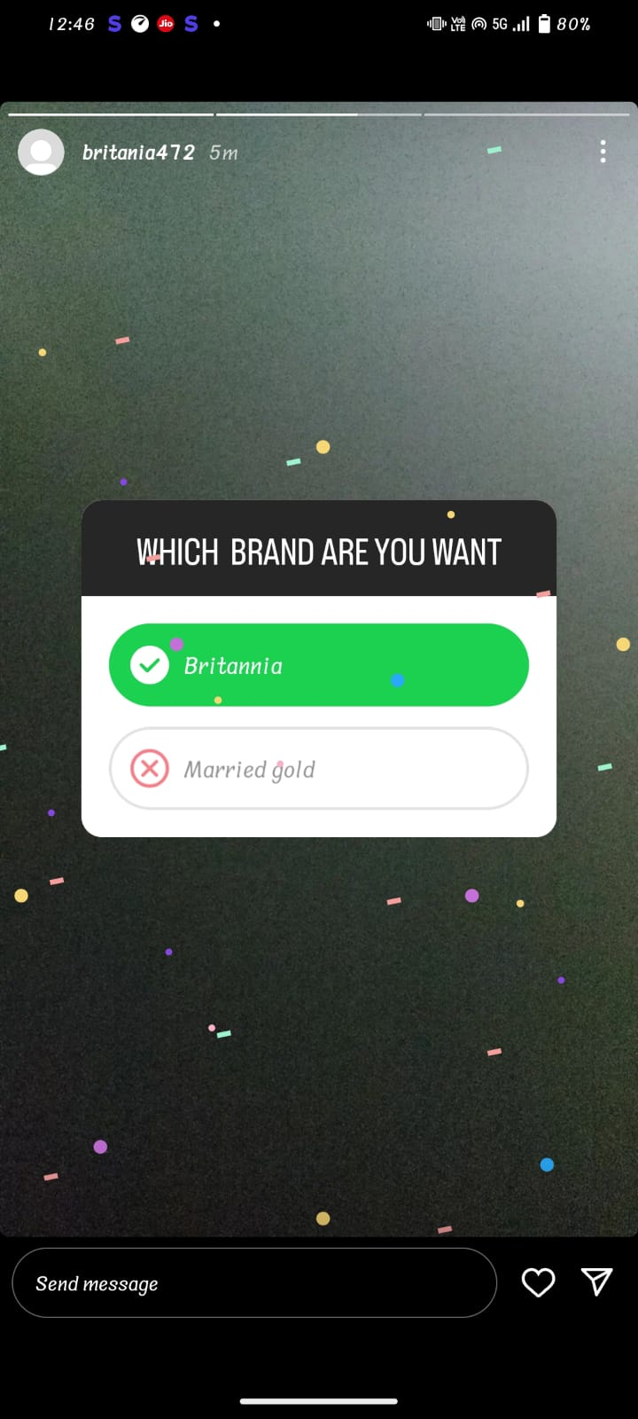

Slide 12
Social Media Links…
Please check my Instagram profile :
https://instagram.com/stories/britania472/3213233144882038740?igshid=NjZiM2M3MzIxNA==
Please check my stories /highlights in Instagram
https://instagram.com/stories/britania472/3213234731369148701?igshid=NjZiM2M3MzIxNA==
https://instagram.com/stories/britania472/3213236222704317354?igshid=NjZiM2M3MzIxNA==
https://instagram.com/stories/britania472/3213233144882038740?igshid=NjZiM2M3MzIxNA==

